Slide 1


GLOBAL ACADEMY OF TECHNOLOGY DEPARTMENT OF COMPUTER SCIENCE AND ENGINEERING (Accredited by NBA 2019-2022) Academic Year : 2019 - 20 ODD Sem
Subject Name | Project Work | Subject Code | 15CSP78
Student Name | PRAVEEN V | USN | 1GA16CS101
 | YASHAS C R |  | 1GA16CS182
 | THEJASVEE M |  | 1GA16CS195
 | SNEHA SURENDRA |  | 1GA16CS198
Domain | DEEP LEARNING | Group No: | 53
Project Title | “ EXPERT SYSTEMS FOR DIFFERENTIAL DIAGNOSIS USING DEEP LEARNING ”
Under taken at | GLOBAL ACADEMY OF TECHNOLOGY
Guide Name | JYOTHI R

Slide 2
Agenda
Introduction
Literature Survey
Objectives
Problem statement
Requirements Specification
Architecture Diagram
Module Split-ups and algorithms used
Bibliography

Slide 3
Introduction
Artificial Intelligence.
Deep Learning: Subset of Machine Learning
Benefits of Deep Learning over Machine Learning.
Neural network helps in understanding the underlying relationships among the symptoms and map it to the most probable diseases.
Implementation of machine learning for differential diagnosis.

Slide 4
Literature Survey
Title of the paper with citation | Methodology | Advantages | Disadvantages
Medical Diagnosis System using Machine Learning | Designing an automated system along with creating database for specific diseases. An algorithm is also proposed. | More reliable and faster than the conventional systems. | Focuses on a single disease and algorithm.
From expert systems to machine-learned diagnosis model | To merge both approaches by using expert systems as generative models that create simulated data on which models can be learned. | Includes the relationship between expert systems and simulated data | Model will give the best output only for diagnosing simple diseases and cannot learn on its experiences.
Machine Learning applied to the detection of retinal blood vessels | An attempt to improve upon the accuracy of retinal image segmentation using supervised (support vector machine) and unsupervised (modified k-nearest neighbor) machine learning algorithms. | Simplifies the method of determining the segmentation of the circulatory system | Able to diagnose only those diseases that can be detected using retinal scans
A Study on Machine Learning algorithm in medical diagnosis | Main objective is to design a medical diagnosis software using Machine Learning algorithms | Completely data driven and have the capability of examining the large amount of data | Statistical models cannot handle categorical data with missing values and large data points
Application of Neural Networks in Early Detection and Diagnosis of Parkinson's Disease | A method in early detection and diagnosis of PD by using the Multilayer Feedforward Neural Network (MLFNN) with Back-propagation (BP) algorithm. | ROC graph is used to assess the performance of a classifier | Attributes used in this research are related only to the frequencies of voice

Slide 5
Objectives
To set up an environment that records the patient’s history and symptoms and analyses the condition.
Diagnose the symptoms causing almost all kind of liver diseases
And finally, to predict the most probable diseases by which liver is affected.

Slide 6
Problem Statement
Develop an automated diagnosing system for patients provided with the patient’s conditions, test results and history and listing out accurately the most appropriate diseases causing the symptoms which can improve the rate of diagnosing drastically, increase the probability of permanent cure and thus saving millions of life.

Slide 7
Requirements Specification
Hardware Requirements
PC with 8gb RAM
i7 processor
50GB HDD
Software Requirements
Windows 10
Python
Anaconda
Jupyter Notebook
Tensorflow
Keras
Google Cloud Platform

Slide 8
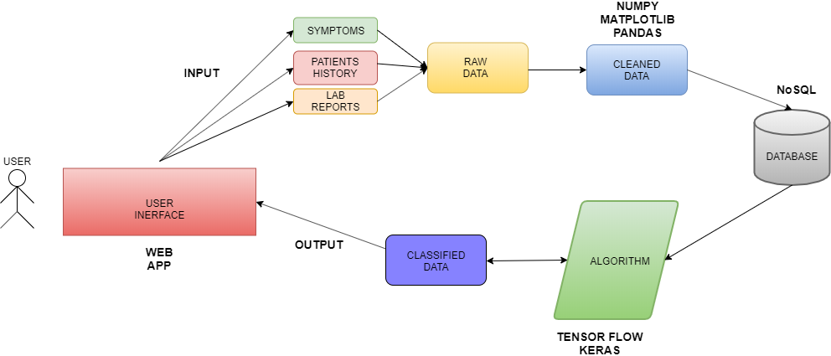
Architecture Diagram of the project

Slide 9
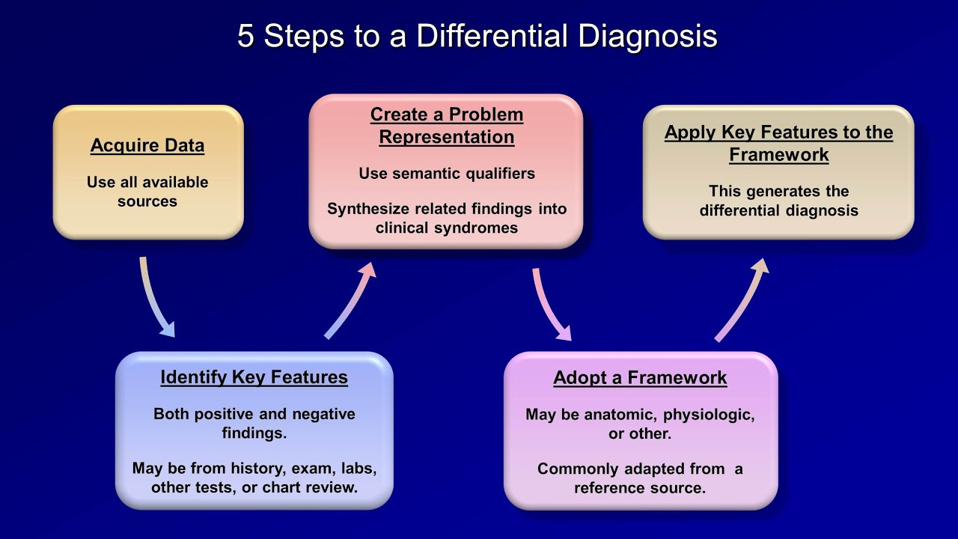
FLOW DIAGRAM

Slide 10
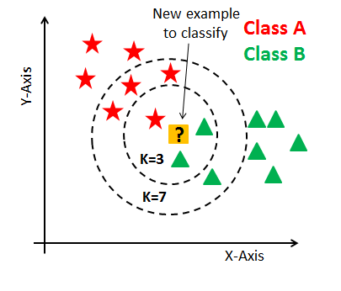
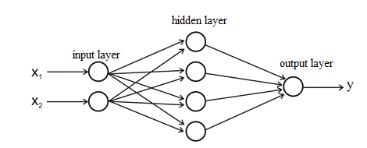
Modules
Database
Collection of Raw Data
Data Cleaning
Modelling
Algorithms- Feed Forward Network-ANN Back Propagation-KNN.
Output
Web Interface for the User.

Slide 11

PAPER PRESENTATION
Fest: Panacea 2k19
Competition: Tech the Med.
Title: Expert Systems For Differential Diagnosis Using Deep Learning.
Held at: Bangalore Medical College Research Institute.
Date: 18th Oct 2019
WINNER!

Slide 12
Bibiliography
[1] Murali Ravuri, Anitha Kannan, “From expert system to machine-learned diagnosis models, Proceedings of Machine Learning Research , Machine Learning for Healthcare,85,1–16, 2018.
[2] Dhaval Raval, Dvijesh Bhatt, “Medical diagnosis system using Machine Learning, International Journal of computer science , Machine Learning for Healthcare, Volume 7,1–6, 2016.
[3]Dr A N Jayanthi, Ms D Pavithra, “A Study On Machine Learning Algorithm In Medical Diagnosis”, International Journal of Advanced Research in Computer Science, Volume 9,No 4, July-August 2018.
[4] Shaik Razia,N Vamsi Krishna,”A Review On Disease Diagnosis Using Machine Learning Techniques” , International Journal of Pure and Applied Mathematics, Volume 117 No. 16 2017, 79-85.
[5] Alex Yee,” Machine Learning Applied to the Detection of Retinal Blood Vessels, Stanford University.

Slide 13
Thank You

Slide 14
Q & A

